Slide 1
Pre-lab Questions

Slide 2
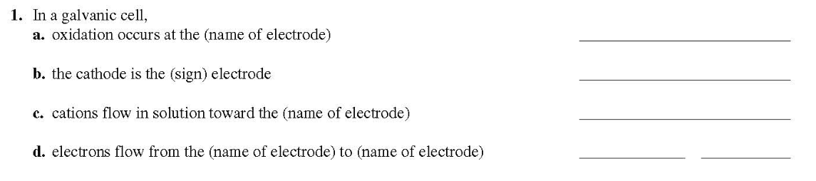
(4 points)
(Name of electrode: anode/cathode, sign: positive/negative)

Slide 3
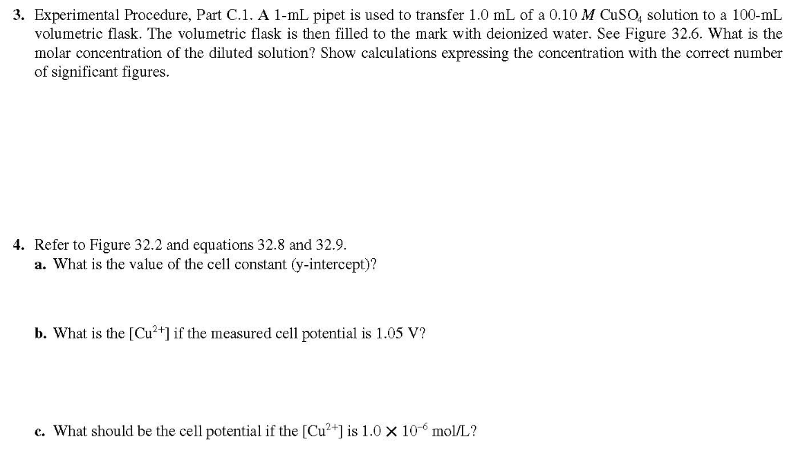
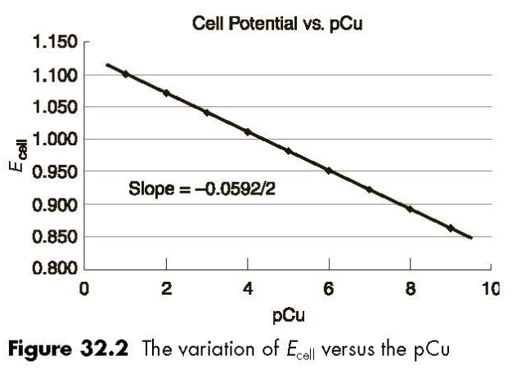
(3 points)
(3 points)

Slide 4
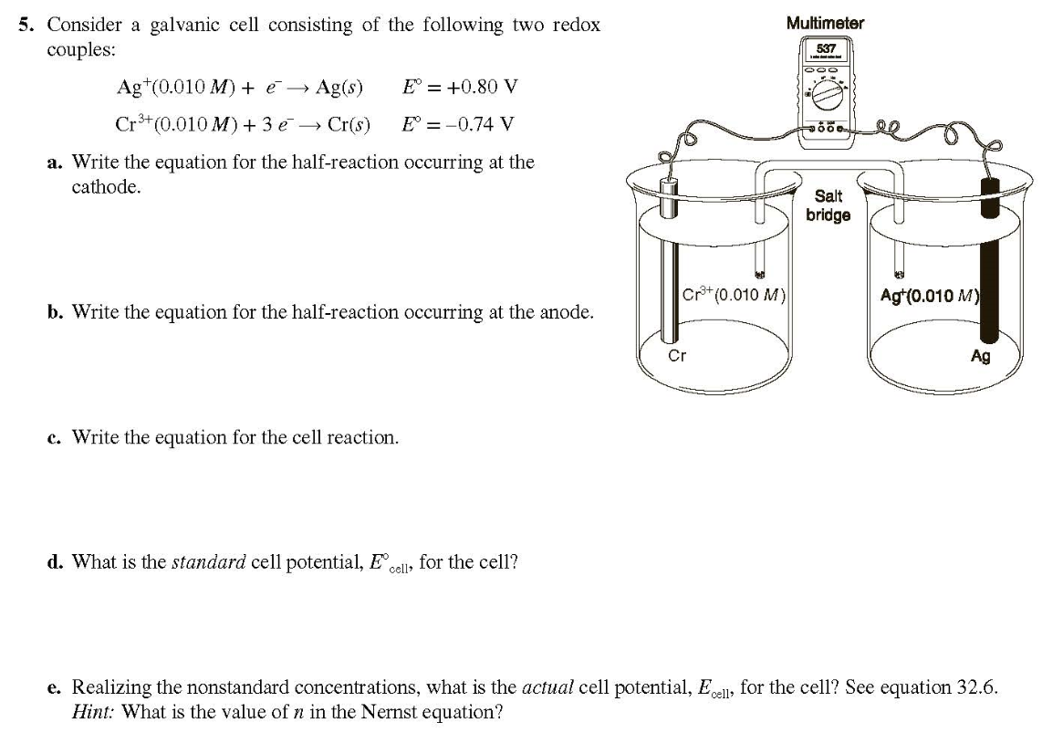
(5 points)

Slide 5
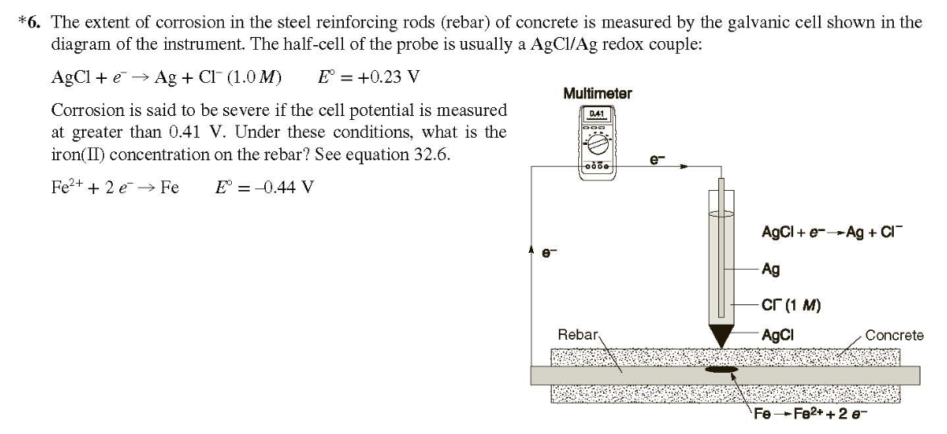
(5 points, No partial points)

Slide 6
Laboratory Reports
Just answer the questions and fill the blanks shown in the manual(page 30~33).
No more discussion(Summary/Assessing the results/Conclusions) is required for this report.

Slide 7
Post-lab Questions
(4 points each)

Slide 8
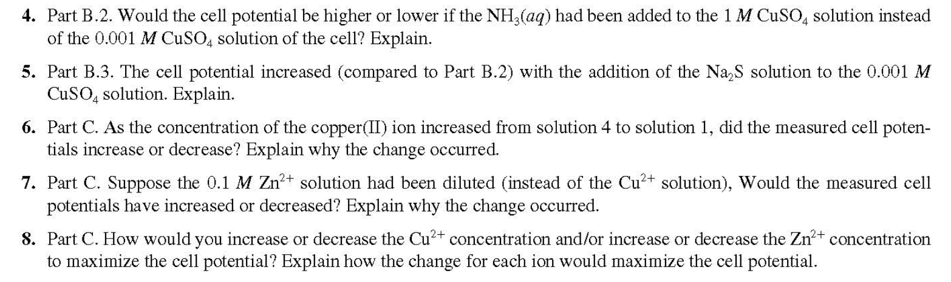

Slide 9
Textbook Content for Exp 10

Slide 10
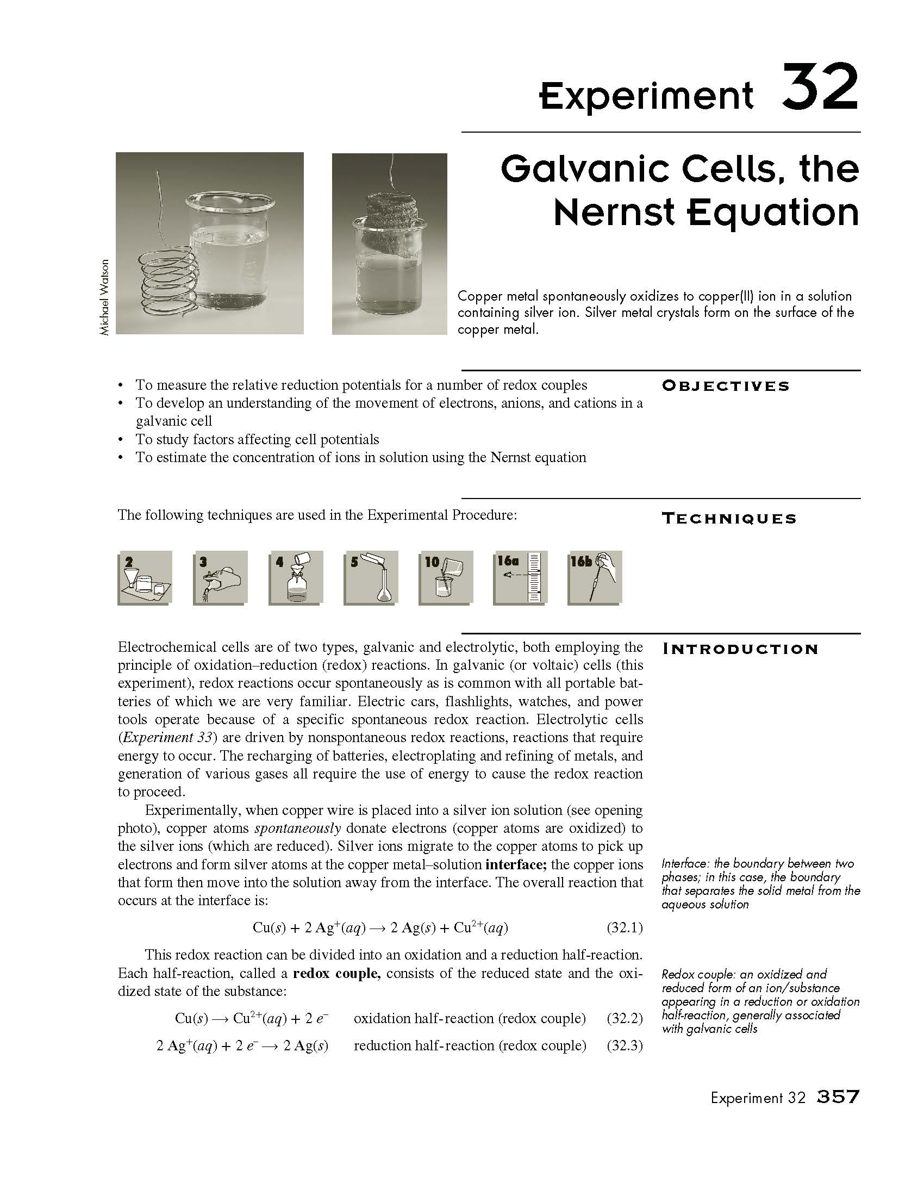
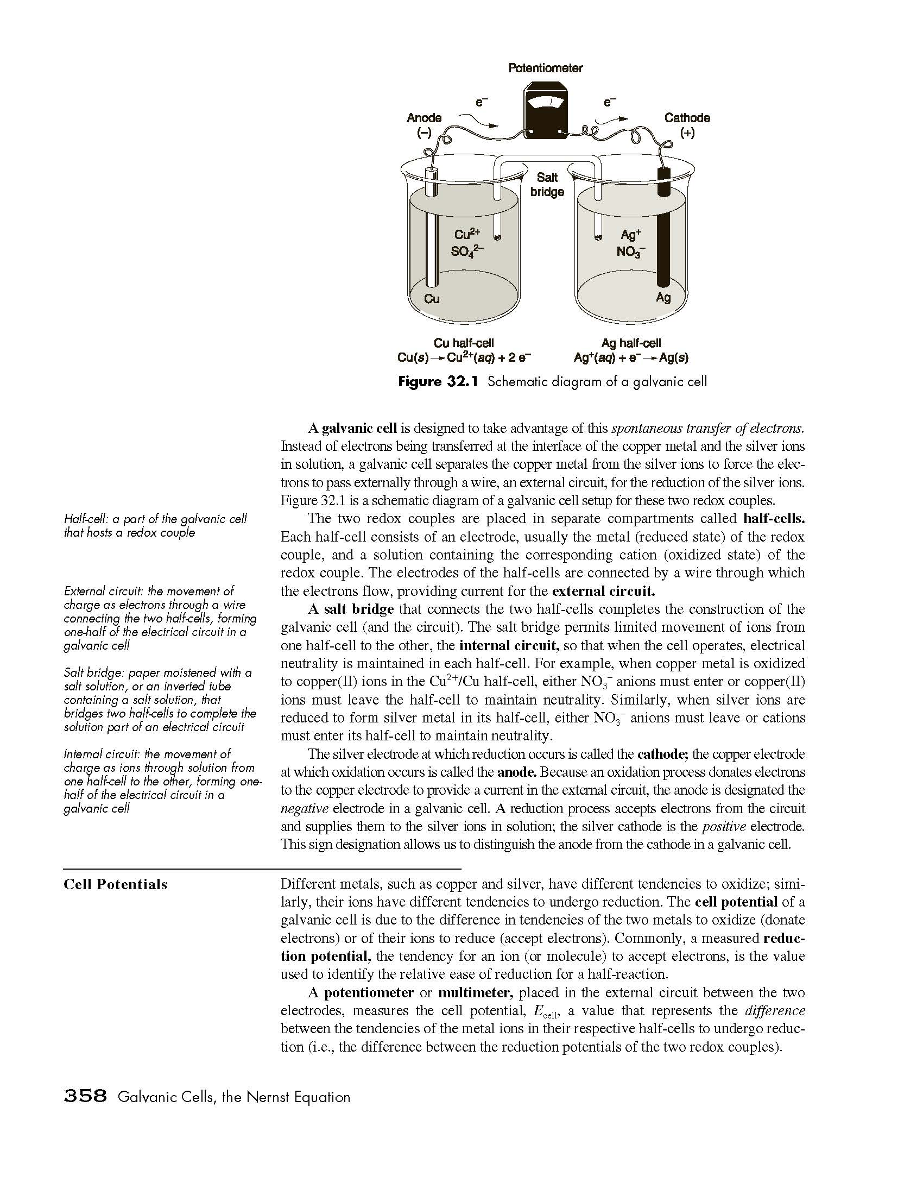

Slide 11
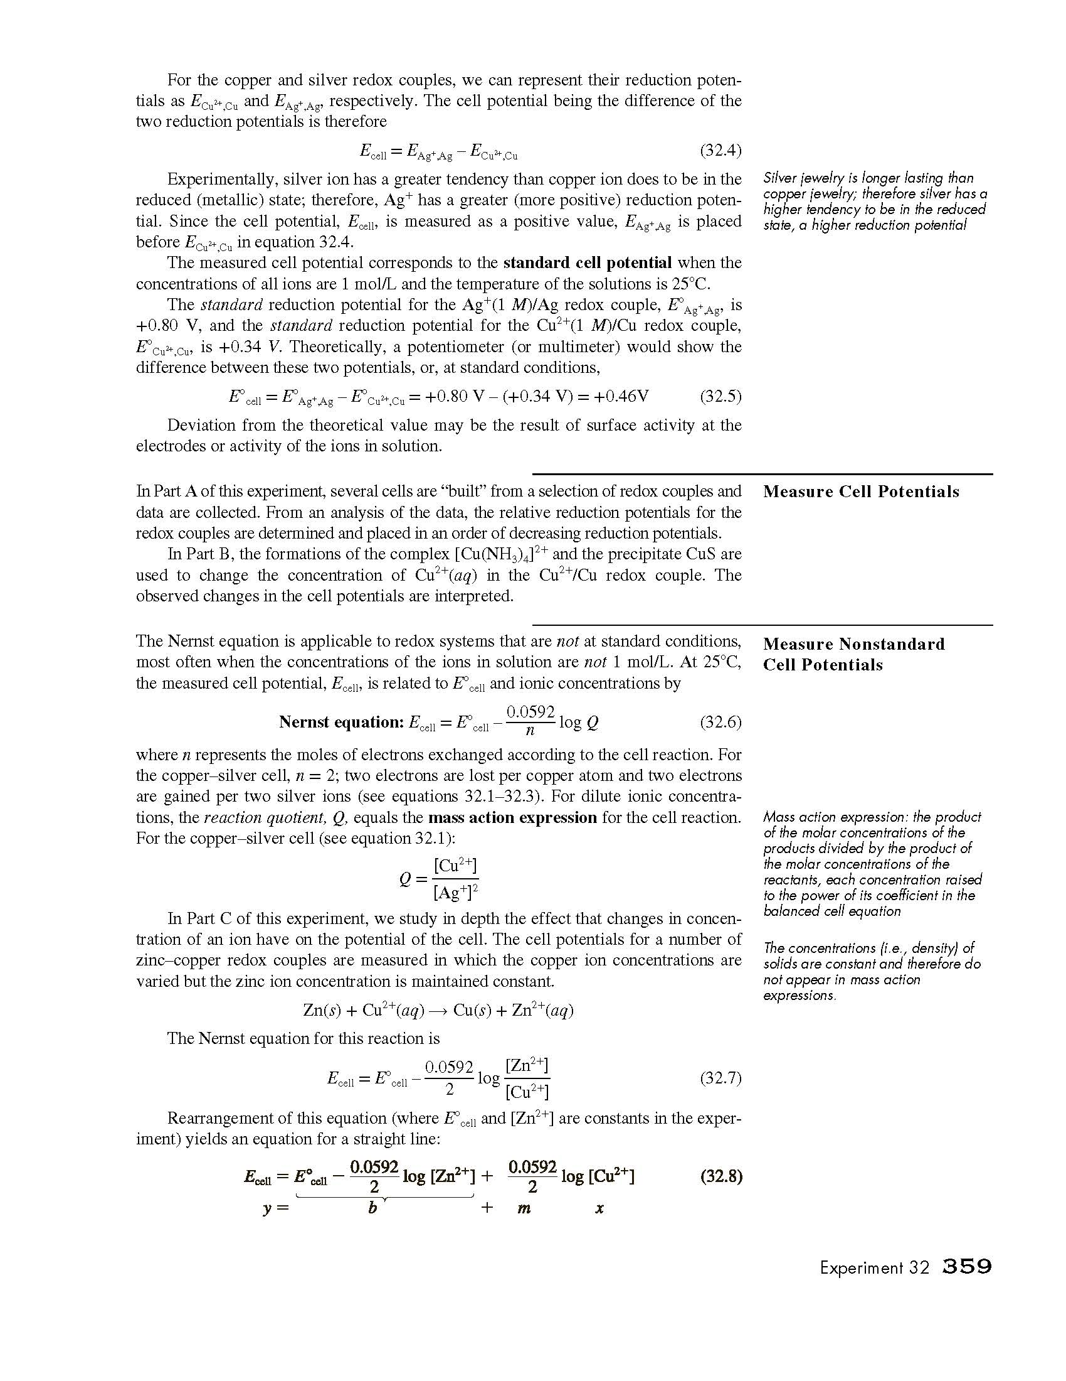
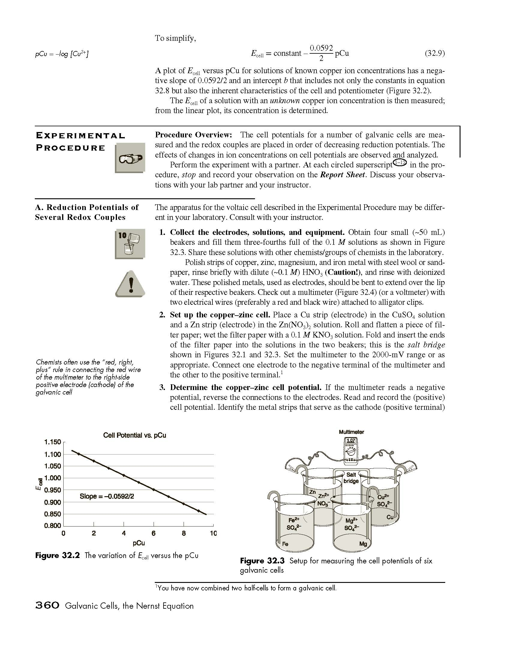

Slide 12
